Slide 1
Text and Texts
EDC&I 583
Message Design
18 January 2012

Slide 2
Order of Business 1/25/12
The Great Blizzard of 2012 (follow-up)
Good/Bad Examples
Last week’s .ppt
Discussion: text and its cousins
Presentations
Discussion: Maps and wayfinding
This week’s .ppt
Lit review: Getting ready for next week

Slide 3
What’s of Interest Here
Origins of texts as learning/teaching tools
Design features in texts that promote learning
Rise of textbook as a distinct phenomenon
Open educational resources/materials
Textbook controversies

Slide 4
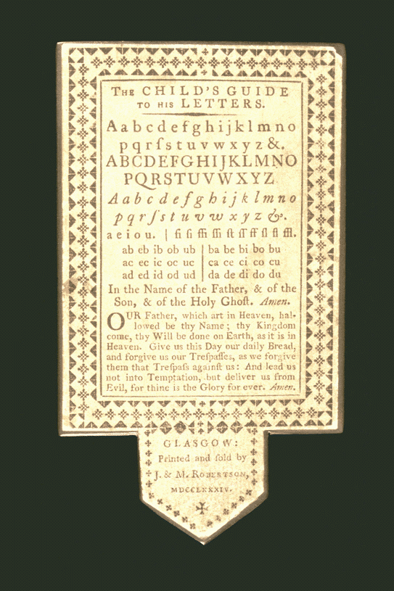
Origins of Texts as Learning/Teaching Tools
Early materials = less “textbook” than primer
Rudimentary schooling, lack of paper/printing facilities
Layer of horn (thin, transparent) over printed sheet ⇒ reusable and durable material

Slide 5
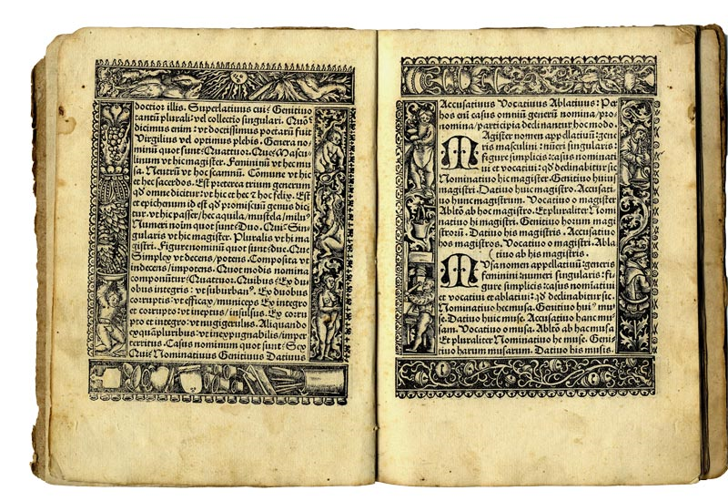
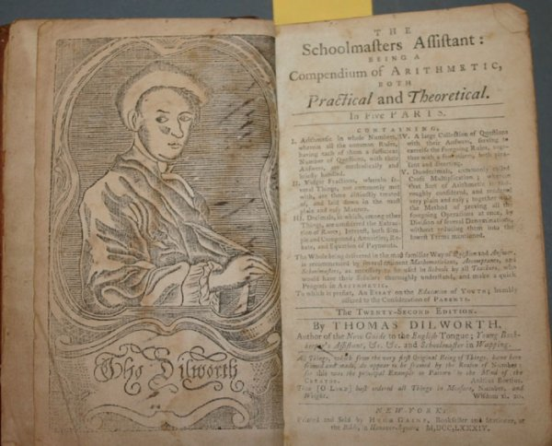
Annotated Editions
Bible, concordances, etc.
Grammars (Aelius Donatus , Ars Minor ⇒) (4th c. AD; so where did you think we got all those “parts of speech” from, anyway?)
Thomas Dilworth, The Schoolmaster’s Assistant ⇒
Arithmetic text; 58 US printings from 1784

Slide 6
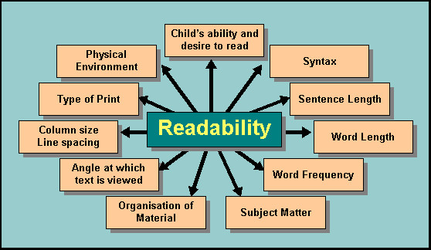
Readability
Early 20th c. interest in creating “one best system” for education
Formulas (Flesch, Dale-Chall), vocabulary lists, sentence structure and length, etc.
Lots to this; we offer multiple courses!

Slide 7
Text Design Features to Promote Learning
Hartley’s grid approach; key elements:
  Line length
  Inter-line spacing
  Numbering systems
  Consistent placement of elements on page
  Type size/line length ratio

Slide 8
Some of Hartley’s Key Points
Not line length or type size per se, but rather keeping chunks of meaning together
Use color sparingly and consistently
Use vertical spacing to enhance meaning
Use horizontal spacing to enhance chunking
  (cf. Robin Williams' points on proximity and intellectual connectedness!!)

Slide 9
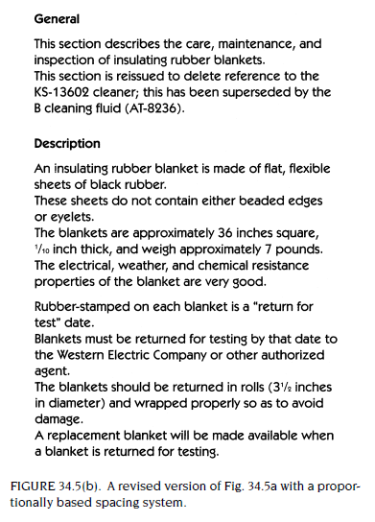
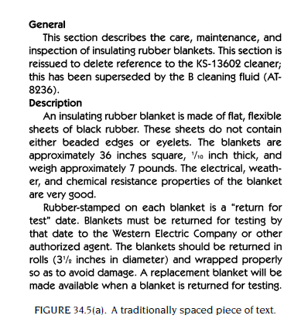
Hartley: Vertical Spacing Comparison

Slide 10
Hartley: Horizontal Spacing Comparison
FIGURE 34.6(a). A piece of text with a traditional justified setting.
Now the sons of Jacob were twelve:
The sons of Leah;
Reuben, Jacob's firstborn,
and Simeon, and Levi, and Judah,
and Issachar, and Zebulun:
The sons of Rachel;
Joseph, and Benjamin:
And the sons of Bilhar, Rachel's handmaid;
Dan, and Naphtali:
And the sons of Zilpah, Leah's handmaid;
Gad, and Asher:
These are the sons of Jacob, which were born
to him in Padan-aram.
FIGURE 34.6(b). The same text with an unjustified setting.

Slide 11
Textbook as Distinct Phenomenon
Emergence in mid-19th c.
Greater standardization and uniformity in education, schooling, college curriculum
Beginnings of teacher preparation as distinct field
Organization of education and rise of ed administration
  Frederick Taylor’s “Scientific management” applied to schools
Many series of readers

Slide 12
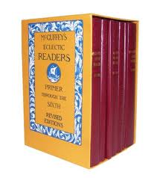
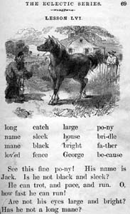
McGuffey’s
McGuffey’s Eclectic Readers = one of first texts produced specifically for teaching and learning
Popular thru 19th c. (and still in use today!)
But not the only such series

Slide 13
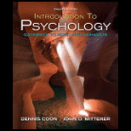
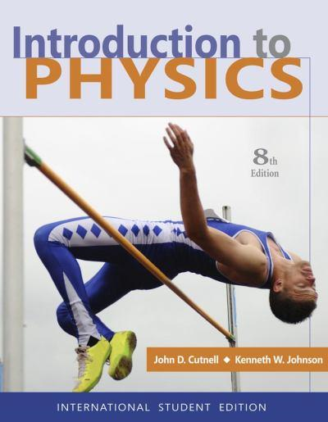
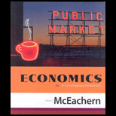
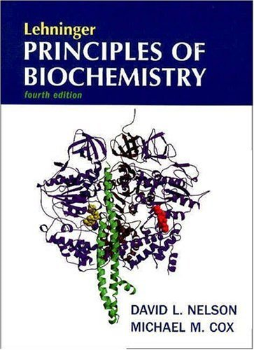

College Textbooks - Current Issues
Textbook costs
Rise of ancillary materials
  course packs, CDs, web sites, etc.
  At K-12, teacher editions, etc.
Increasing “churn” of new editions

Slide 14
Open Educational Resources/Materials
WA SBCTC initiative
Apple’s iBook Textbooks for iPad

Slide 15
Textbook Controversies
Lots of examples in many fields – science, history/social studies, math, political science, literature
  And not just in USA: Japan and Pakistan history texts; Russia literature and computer science texts; etc.
  “Whose history?” [literature/science/etc.] will be taught? How and towards what ends?

Slide 16
Questions to Discuss
  [Cromley] Your experience in learning to “read” complex diagrams? Did you have the sorts of difficulties they found in their study?
  [Souto] Text clouds – have you used them yourself as a way to represent the content of text? Would you, and for what?
  [Williams] Business cards: Have you designed? Do they follow the kinds of rules she lays out? Have you deigned a flyer? Do you think it was successful at grabbing peoples’ attention?

